Slide 1
Phoodie: Restaurant Point of Sale System

Slide 2
Roles
Mel - Development Engineer, QA, Project Manager
Anthony - Development Engineer
Tim - Requirements Engineer
Mitch - Requirements and Development Engineer

Slide 3
Requirements
Previous:
Kitchen Interface
Admin Interface
Tim Parzynski

Slide 4
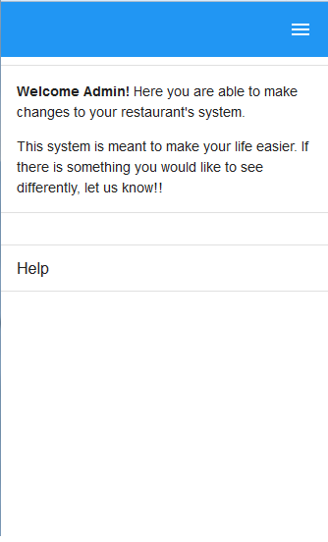
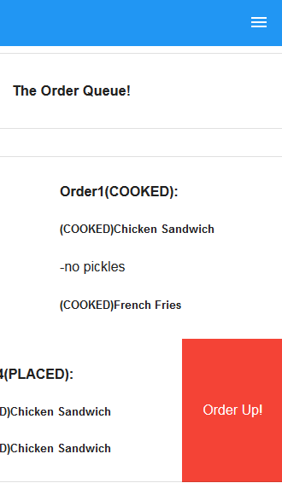
Admin Interface
Iteration 2
Kitchen Interface
Iteration 2
Tim Parzynski

Slide 5
Requirements
Current:
Front of House Interface
Order Food
View Menus
Customer Interface
Order Food
Tim Parzynski

Slide 6
Requirements
SRS Product Functions
Front of House will be able to:
View open seating
Assign guests to open seats
Clear full seats
View the menu
Place orders
Tim Parzynski

Slide 7
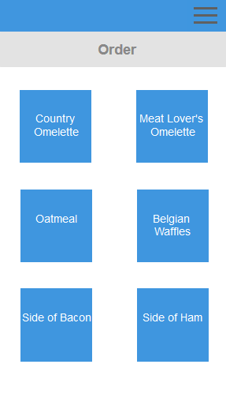
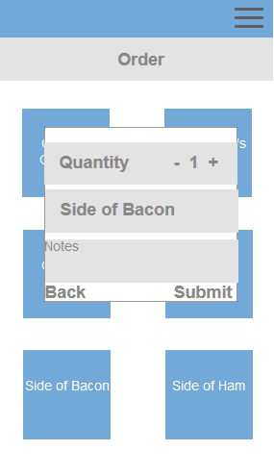
Front of House
Iteration 3
Tim Parzynski

Slide 8
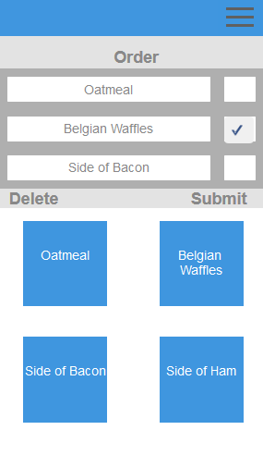
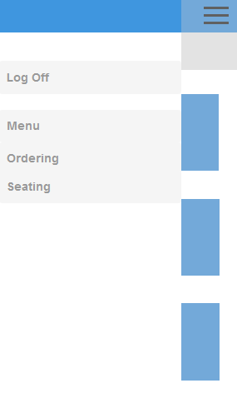
Front of House
Iteration 3
Tim Parzynski

Slide 9
Development: Front End
Current:
Front of House Interface - Menu Page, Wait Staff Ordering, Current Order
Admin Interface - User Controls, Menu Controls
incorporated more jQuery throughout
Mitch

Slide 10
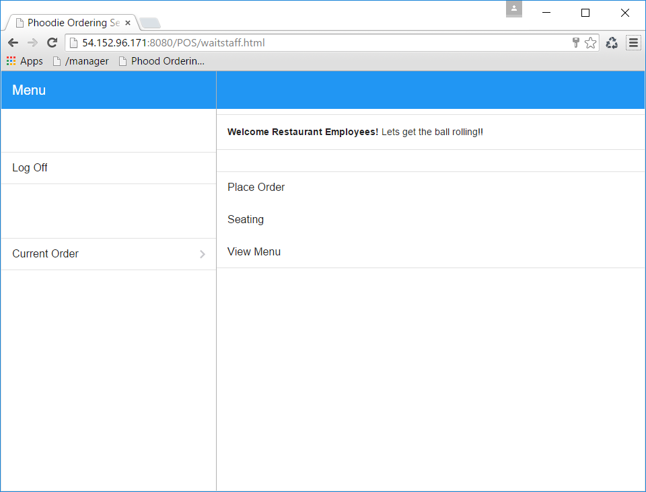

Slide 11
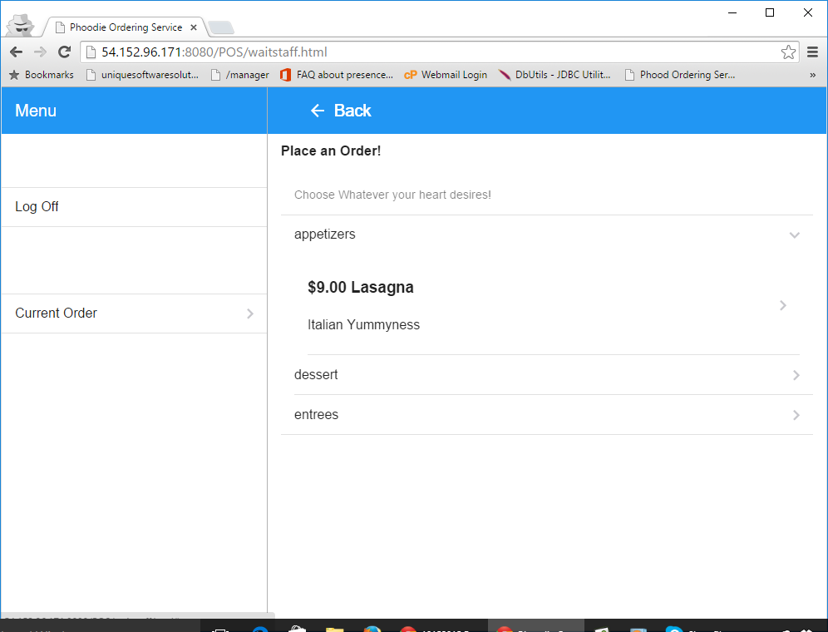

Slide 12
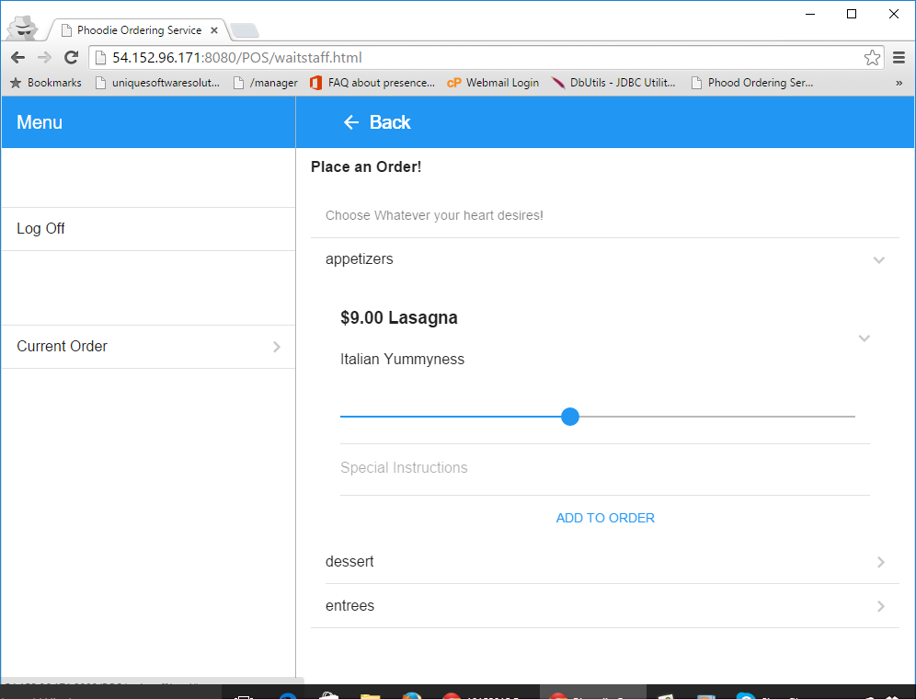

Slide 13
Development: Servlets
Current:
Admin
Add Restaurant User
Add Menu
Add Menu Item
Change Menu
Change Menu Item
Change RestaurantUser
Delete Menu
Delete Menu Item
Delete Restaurant User
Get Restaurant User
Detail Status Changed
List Menus
List Restaurants
Front of House
Place Order
Customer Interface
Place Order
List Restaurants
Anthony

Slide 14
Development
Future:
UI Improvement
Finalize custom templates for FOH to design table layouts
Continue working on layouts
Security
Mel, Mitch, Anthony

Slide 15
QA
Last Time: Nothing
Current:
Kitchen Interface and Server Tests
Admin Interface and Server Tests
Front of House Interface and Server Tests
Future:
Continue Admin Interface and Server Tests
Continue Front of House Interface and Server Tests
MEL CHI

Slide 16
Project Management
Assigned Roles Thursday 10/1
Mapped out plan that day
Changed plan midweek
Changed plan again 10/8
Assigned new work, assigned research for features
MEL CHI

Slide 17
Schedule (Previous)
Date | Iteration | Goals
10/1/2015 | 2 | Kitchen Interface Finished Admin Interface Started MySQL Utilities and String Utilities Main Tables for Kitchen Interface Done
10/8/2015 | 3 | Host(ess)/Waiter(ress) Food Ordering More Security on Server Convert Old Servlets to use Utilities Main Tables for FOH Interface
10/15/2015 | 4 | Security improvements, QA, Sleeker UI
MEL CHI

Slide 18
Schedule (Current)
Date | Iteration | Goals
10/15/2015 | 3 | Host(ess)/Waiter(ress) Food Ordering Servlets Functionality Finished Main Tables for FOH Interface Start Procedures for more complex SQL, or multiple queries in one action
10/22/2015 | 4 | Security improvements, QA, Sleeker UI
MEL CHI

Slide 19
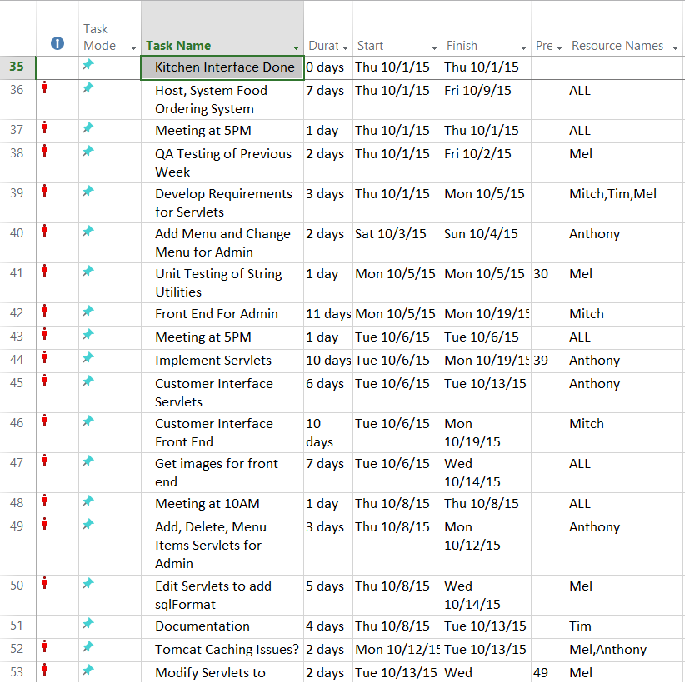
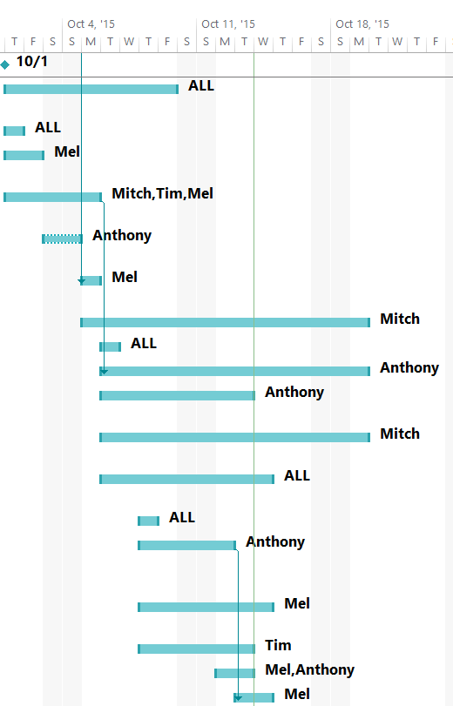
MEL CHI

Slide 20
This Week
Front of House Seating Interface
Security Interface
Bug Fixes, Potential Bugs found through QA
MEL CHI

